Slide 1
Revolutionizing Cloud Infrastructure Deployment:
Unleashing the Power of Integration
Aniket Kumar Sinha, Rapid Circle

Slide 2


Notes:
Challenges in Juggling between GitHub Actions and Terraform Cloud? Managing separate pipelines at two different platforms.

Slide 3
🤝
Notes:
Integration Nirvana

Slide 4

+
Notes:
Integration Nirvana

Slide 5
Prerequisites
Basics of Terraform
Terraform Cloud Account
GitHub Account

Slide 6
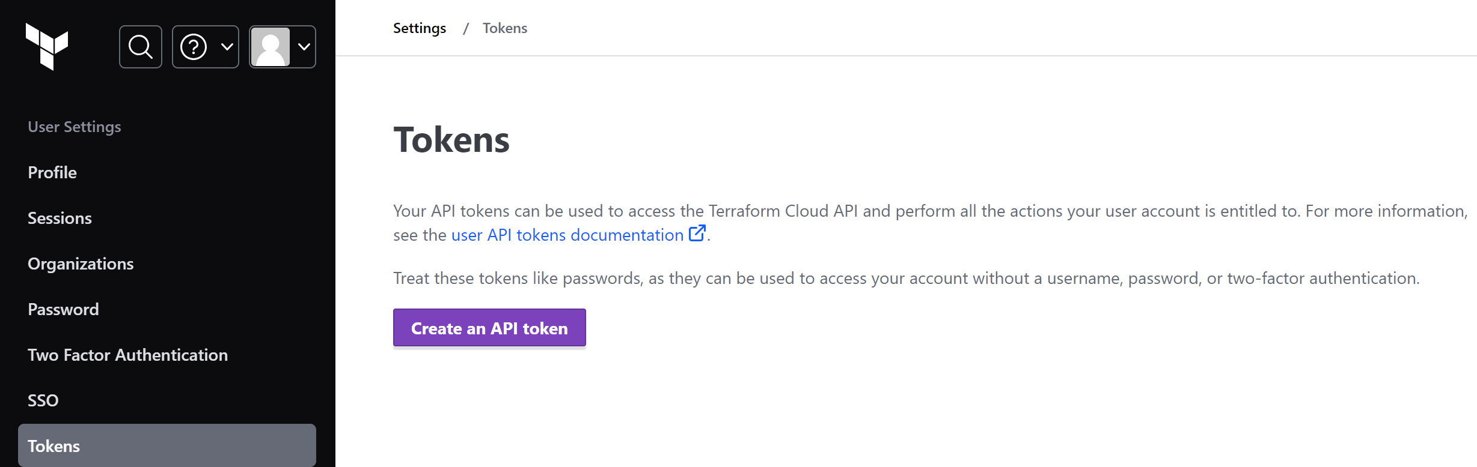
Integration Nirvana Steps
Create Terraform Cloud Workspace with API-driven Workflow.
Create new User API token from User Settings page.

Slide 7
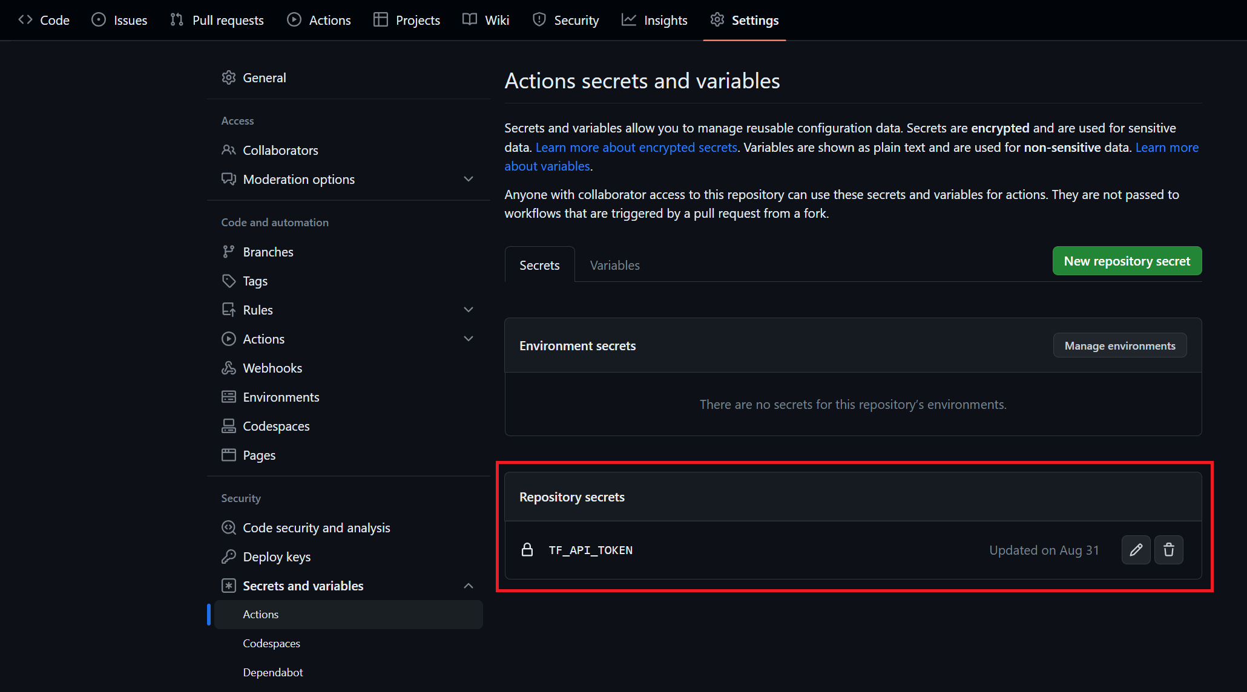
Integration Nirvana Steps
Add the API token as Secret in GitHub repository.

Slide 8
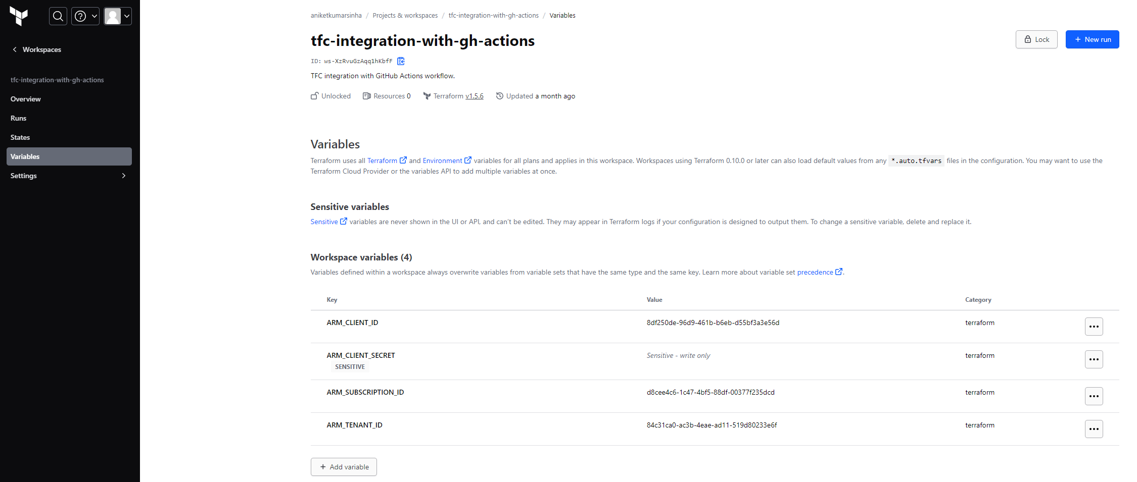
Integration Nirvana Steps
Add Azure details such as Subscription ID, Client ID, Client Secret, and Tenant ID in TFC workspace variables.

Slide 9
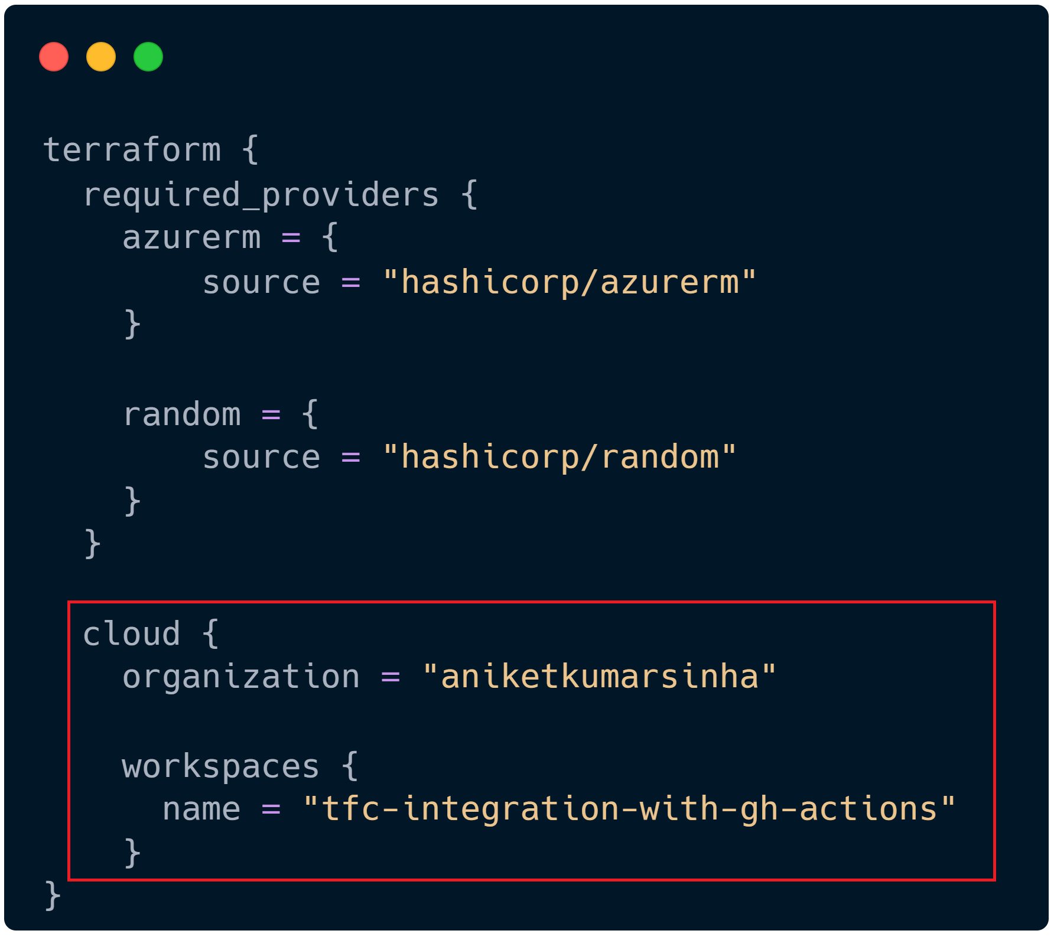
Integration Nirvana Steps
In your GitHub repository create main.tf file with some resource configuration.
Add terraform providers block with specific details of TFC workspace.

Slide 10
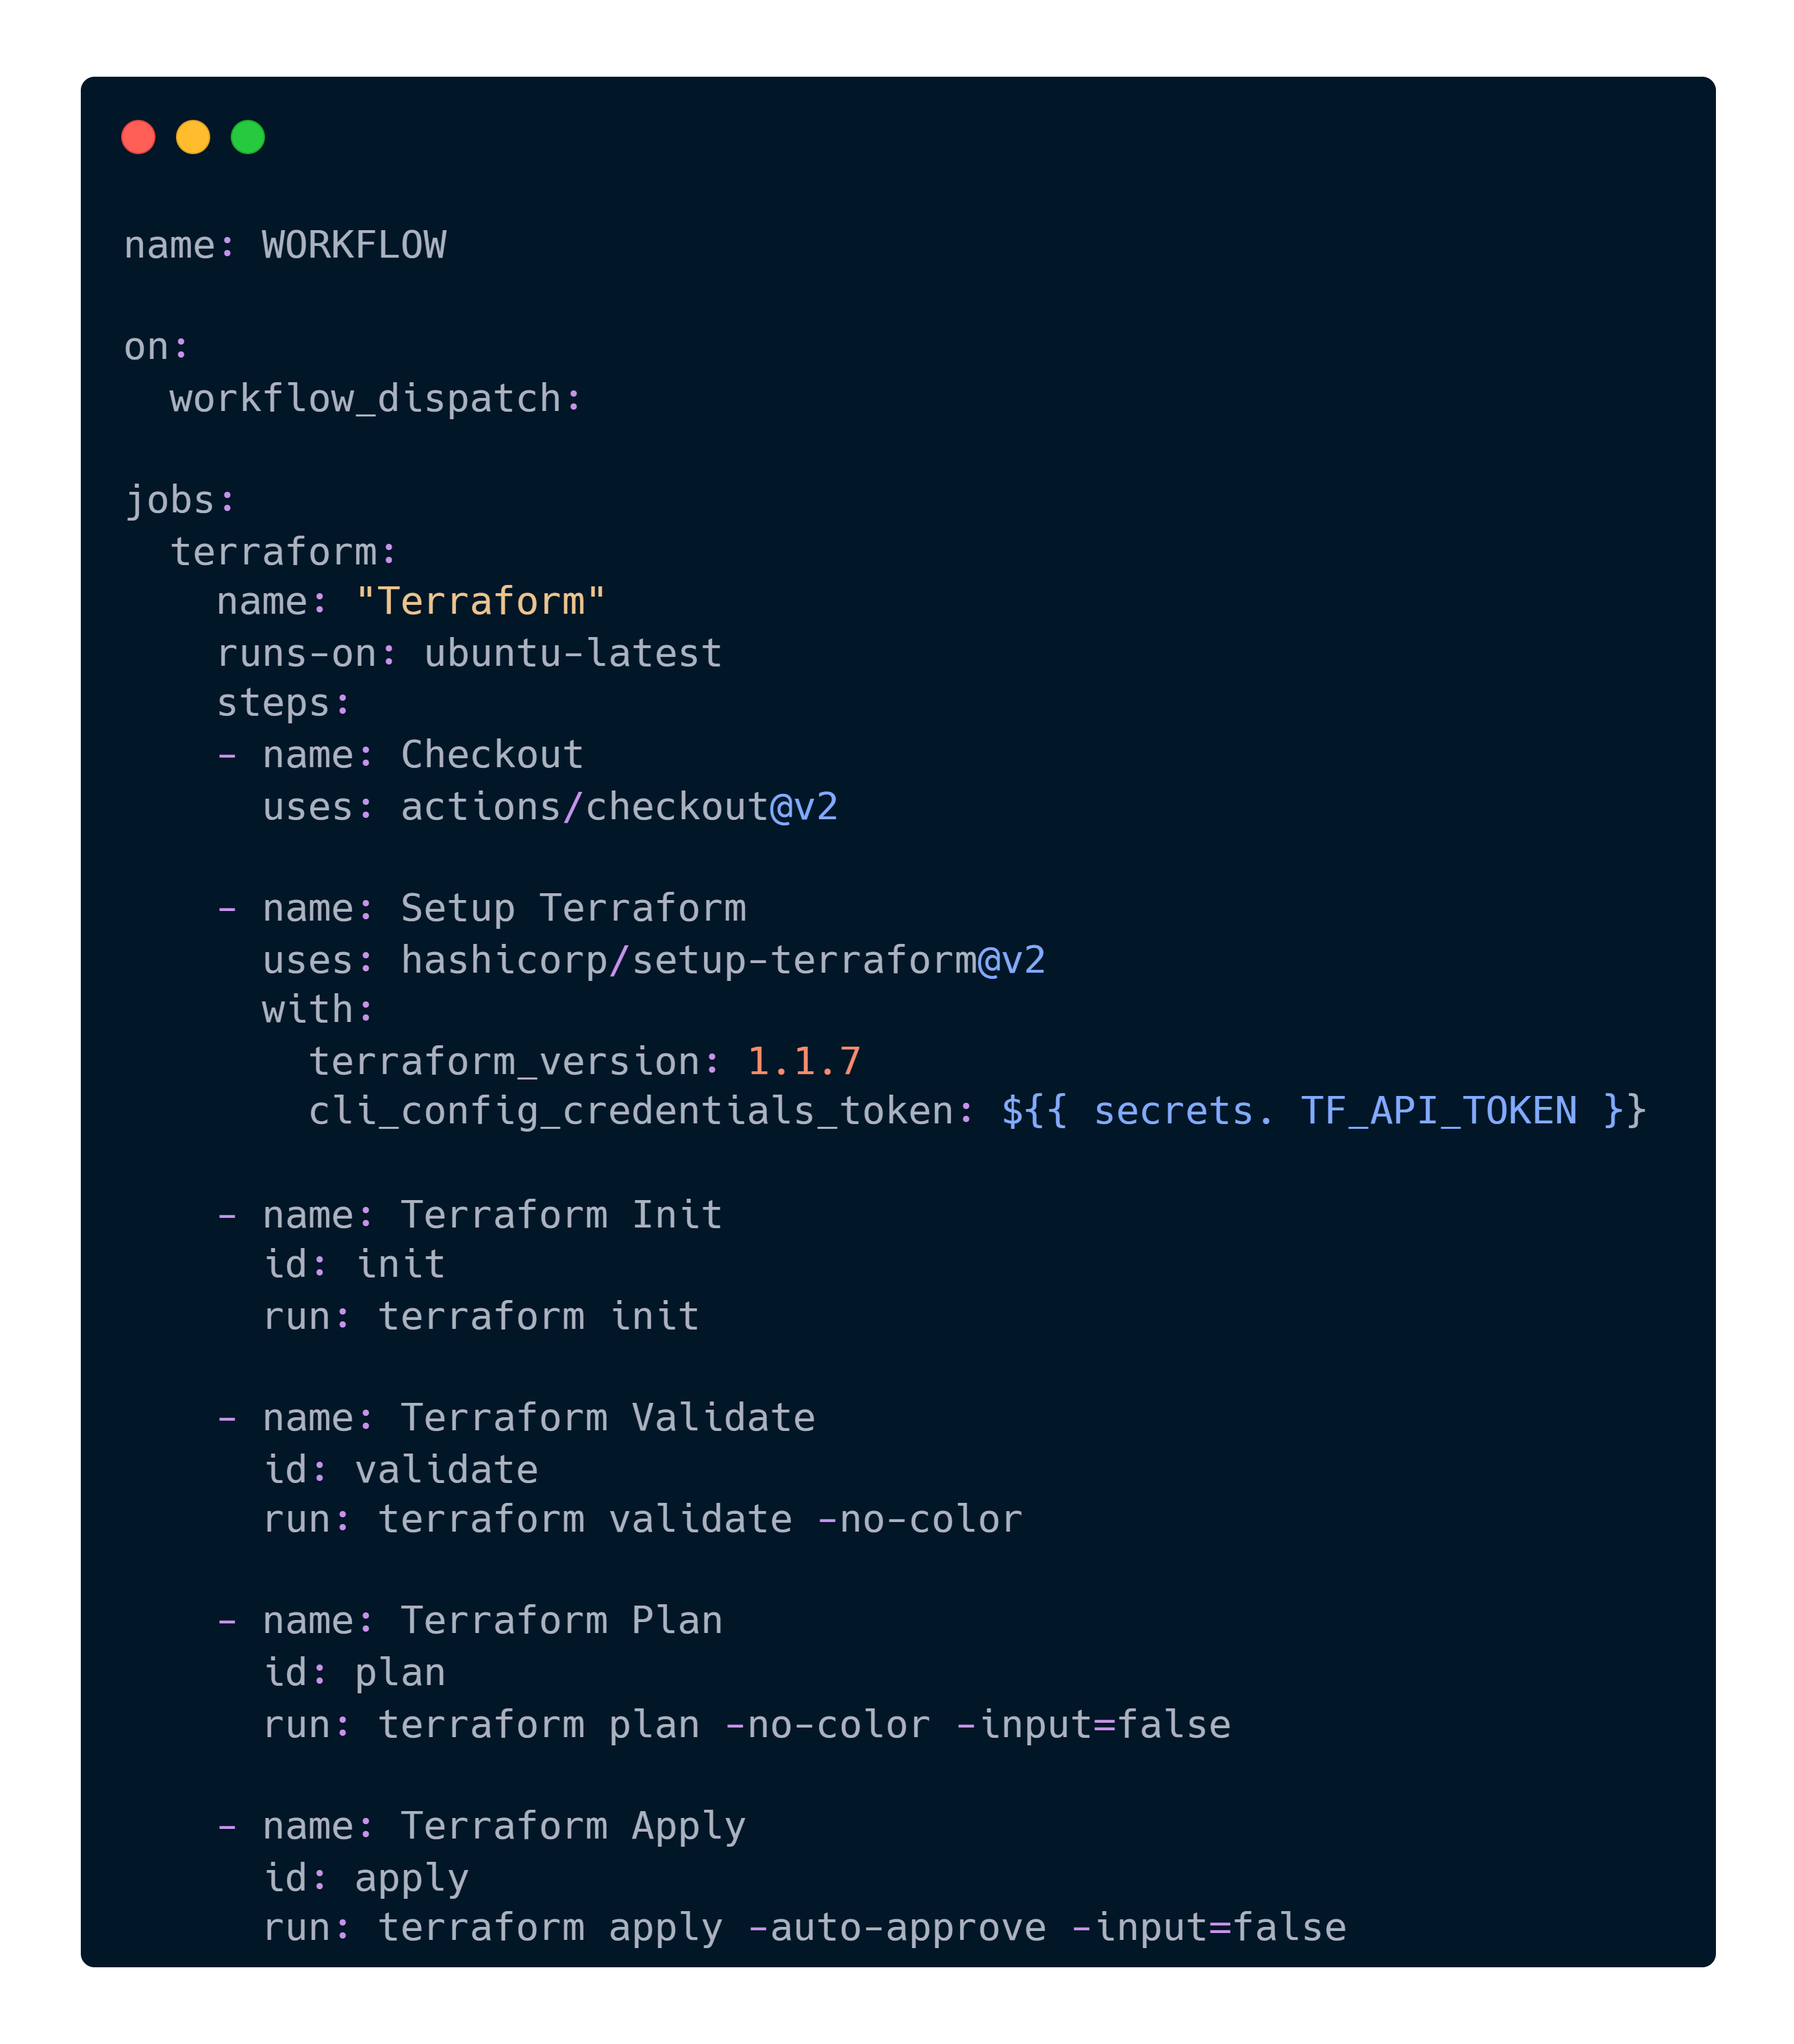
Integration Nirvana Steps
Create the GitHub Actions workflow file with Terraform steps (.github/workflows/deploy.yaml).

Slide 11
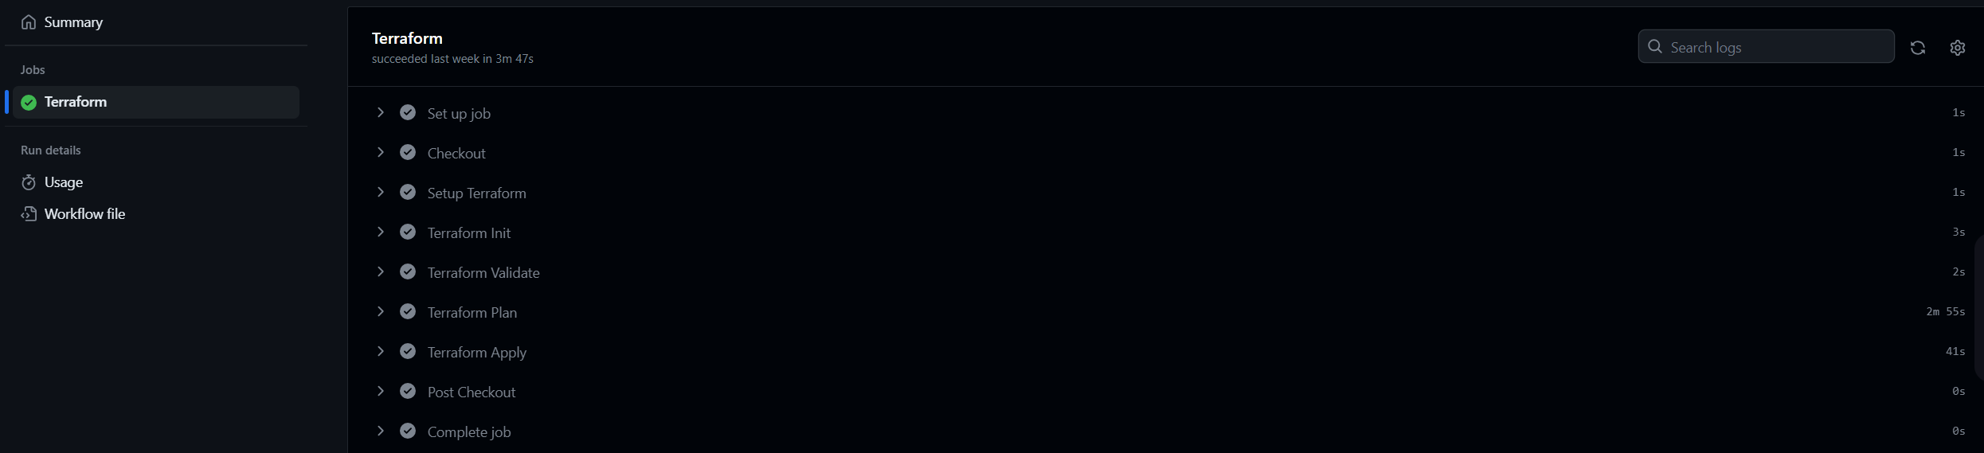
Deployment Show✅
Notes:
Quick real demo go through!

Slide 12


Links to review
Code repository
github.com/aniketkumarsinha/tfc-integration-gh-action
State file migration
bit.ly/tf-statefile-migration

Slide 13


Thank you…
Connect with me:
linktr.ee/aniketkumarsinha

